Slide 1
RMI , Naming Service, Serialization and Internationalization Unit 4

Slide 2

A Simple Overview
Java RMI allows one Java object to call methods on another Java object in a different JVM
Client JVM
Method parameters
Local
Object
Remote
Object
Result or exception
Server JVM
2

Slide 3
What is RMI?
RMI stands for “Remote Method Invocation” means communicating the object across the network.
RMI is a system that allows
an object running in one Java virtual machine (Client) to invoke methods on an object running in another Java virtual machine (Server).
This object is called a Remote Object and such a system is also called RMI Distributed Application

Slide 4
Distributed Programming
Java RMI is interface based
A remote object (or distributed service) is specified by its interface
“interfaces define behaviour and classes define implementations”
Termed Remote Interfaces
Interface
Implementation
RMI System
Client Program
Server Program
4

Slide 5
RMI vs. Socket-Level Programming
Higher level of abstraction.
It hides the details of socket server, socket, connection, and sending or receiving data
Scalable and easy to maintain.
RMI clients can directly invoke the server method, whereas socket-level programming is limited to passing values.

Slide 6
RMI Architecture
The complete RMI system has a FOUR layer,
(1) Application Layer
(2) Proxy Layer
(3) Remote Reference Layer
(4) Transport Layer
Mainly the RMI application contains the THREE components,
(1) RMI Server
(2) RMI Client
(3) RMI Registry

Slide 7
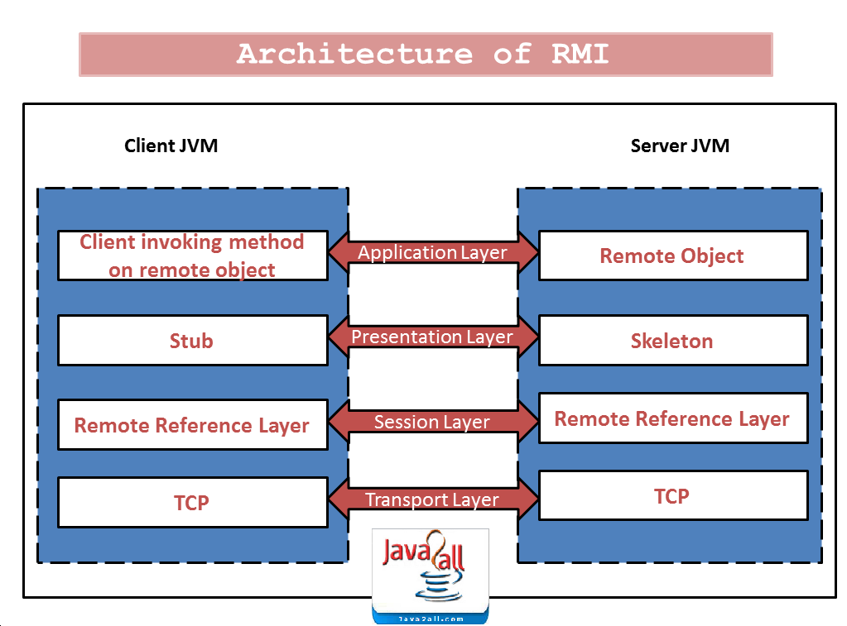

Slide 8
Stubs and Skeleton Layer
Stubs and skeletons are generated from the remote interface
Using the “rmic” Java tool
Interface
Client
Server
Stub
Skel
Stub communicates with a skeleton rather than the remote object
This a Proxy approach
Marshalls the parameters and results to be sent across the wire
8

Slide 9
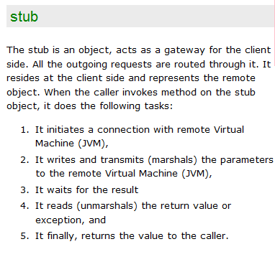
Stub and Skeleton

Slide 10
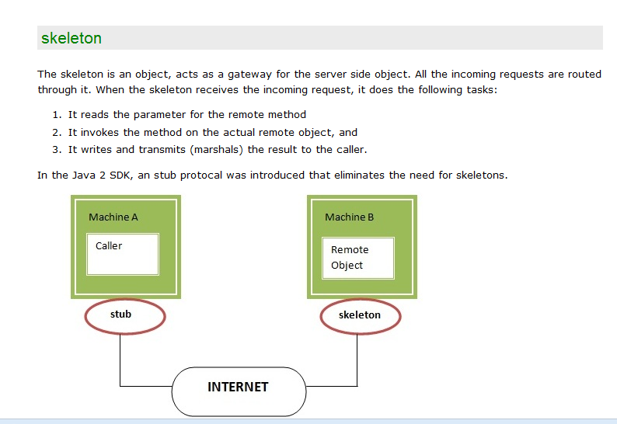

Slide 11
Parameter Passing(1)
Parameter Passing in Java RMI is different from standard Java
Reminder: In Java, primitives are passed by value, Objects are passed by reference
In Java RMI
Objects and primitives are passed by value
Remote objects are passed by reference
11

Slide 12
Parameter Passing (2)
RMI-Pass by Value
All ordinary objects and primitives are serialised and a copy is passed
Any changes to the copy do not affect the original
RMI-Pass by Reference
Remote Object is the parameter, a stub (reference) is sent
the stub is used to modify the object, the original object is modified
12

Slide 13
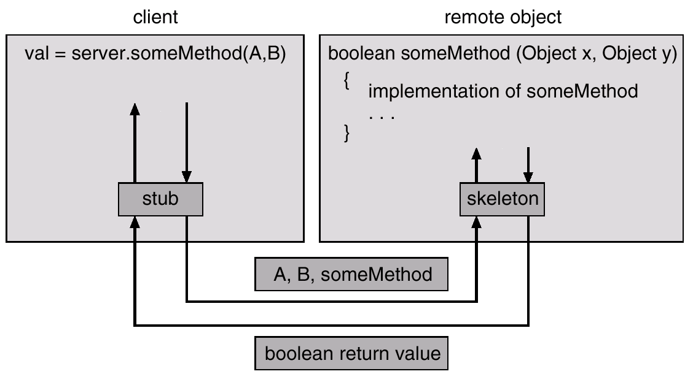

Slide 14
Remote Reference Layer
Responsible for
Connection management (stub and skeleton)
For example, if a remote object is part of a replicated object, the client-side component can forward the invocation to each replica rather than just a single remote object.

Slide 15
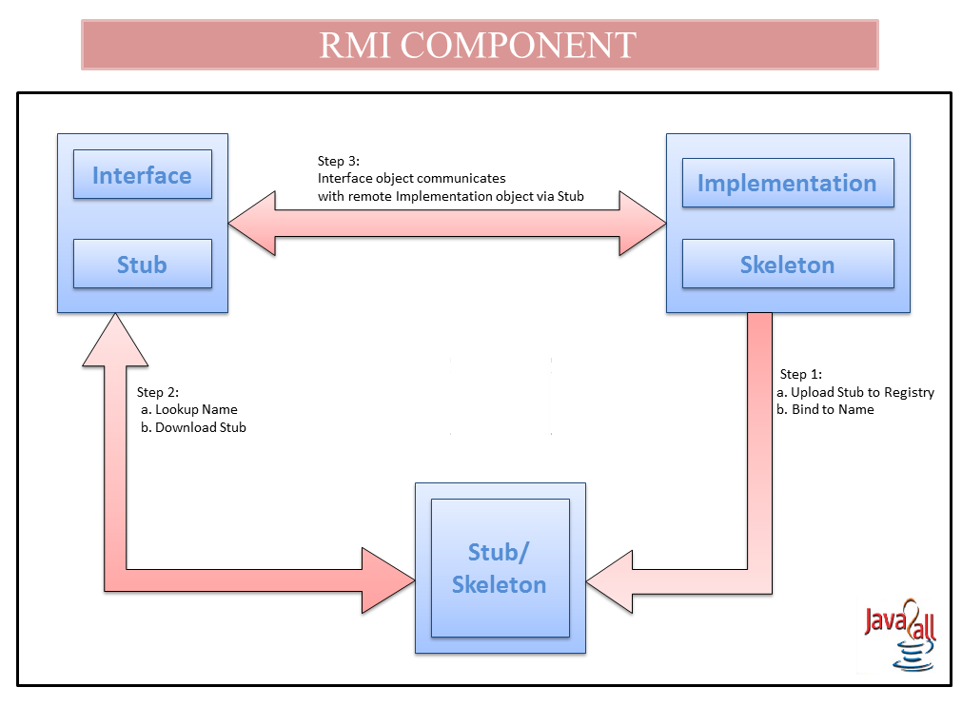

Slide 16
The RMI Registry
The RMI Registry is a naming service
Separately Running service
Initiated using Java’s “rmiregistry” tool
Server programs register remote objects
Give the object a name it can be found using
Client programs lookup object references that match this service name
Registry names have a URL format
rmi://<hostname>:<port>/<ServiceName>
E.g. rmi://localhost:1099/CalculatorService
E.g. rmi://194.80.36.30:1099/ChatService
16

Slide 17
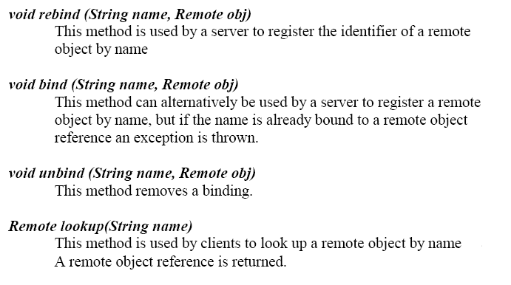
The RMI Registry Interface
17

Slide 18
Lookup in Java RMI
Interface
Remote Object
Client Program
Server Program
naming.lookup(“rmi://localhost:1099/ TestService”)
naming.rebind(“rmi://localhost:1099/TestS
ervice”, RemoteObjectReference)
Server
Client
RMIRegistry
Local Machine
18

Slide 19
Calculator.java
import java.rmi.Remote;
import java.rmi.RemoteException;
public interface Calculator extends Remote
{
public long addition (long a,long b) throws RemoteException;
public long subtraction (long a,long b) throws RemoteException;
public long multiplication (long a,long b) throws RemoteException;
public long division (long a,long b) throws RemoteException;
}

Slide 20
CalculatorImpl.java
import java.rmi.RemoteException;
import java.rmi.server.UnicastRemoteObject;
public class CalculatorImpl extends UnicastRemoteObject implements Calculator
{
protected CalculatorImpl() throws RemoteException
{
super();
}
public long addition (long a, long b) throws RemoteException
{
return a+b;
}
public long subtraction (long a, long b) throws RemoteException
{
return a-b;
}
public long multiplication (long a, long b) throws RemoteException
{
return a*b;
}
public long division (long a, long b) throws RemoteException
{
return a/b;
}

Slide 21
CalculatorServer.java
import java.rmi.Naming;
public class CalculatorServer
{
CalculatorServer()
{
try
{
Calculator c = new CalculatorImpl();
Naming.rebind("rmi://localhost:1099/CalculatorService", c);
}
catch (Exception e)
{
System.out.println("Exception is : "+e);
}
}
public static void main(String[] args)
{
new CalculatorServer();
}
}

Slide 22
CalculatorClient.java
import java.rmi.Naming;
public class CalculatorClient
{
public static void main(String[] args)
{
try
{
Calculator c = (Calculator) Naming.lookup("//127.0.0.1:1099/CalculatorService");
System.out.println("Addition : "+c.addition(10,5));
System.out.println("Subtraction : "+c.subtraction(10,5));
System.out.println("Multiplication :"+c.multiplication(10,5));
System.out.println("Division : "+c. division(10,5));
}
catch (Exception e)
{
System.out.println("Exception is :"+e);
}
} }

Slide 23
Steps to Run RMI Program(1)
javac Calculator.java
javac CalculatorImpl.java
javac CalculatorServer.java
javac CalculatorClient.java

Slide 24
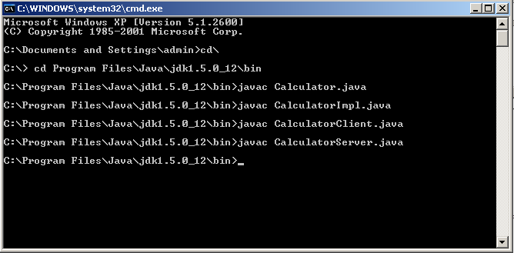
RUN Java File
rmic CalculatorImpl
start rmiregistry

Slide 25
Steps to Run RMI Program(2)
rmic CalculatorImpl
start rmiregistry

Slide 26
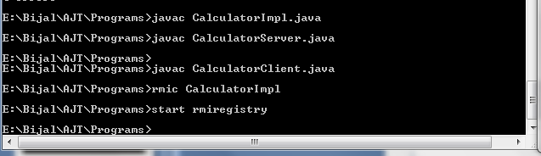
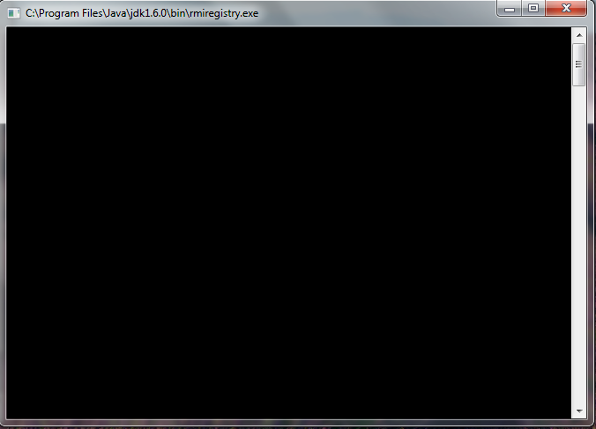
Run RMI Registry

Slide 27
Steps to Run RMI Program(3)
After Opening Registry
java CalculatorServer
Open another Command Prompt
java CalculatorClient

Slide 28
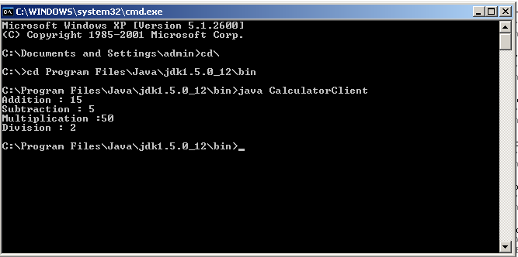
Run Client

Slide 29
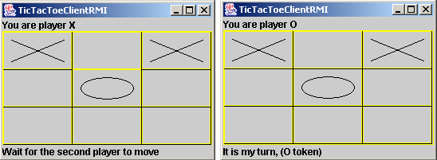
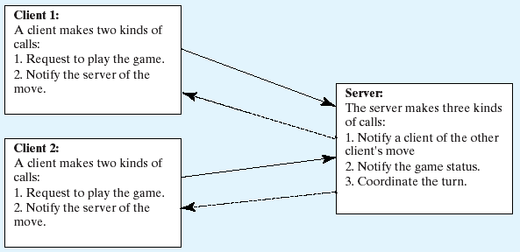
Example: Distributed TicTacToe Using RMI
, “Distributed TicTacToe Game,” was developed using stream socket programming.

Slide 30
Naming Service
Assign a standard name to a given set of data
Ex :
Email address
Binding a Web Name with URL.
DNS(Domain Name Server)

Slide 31
Object Serialization
To pass user created objects as parameters in RMI they must be serializable
This is easy in Java – simply make the class implement the Serializable interface
If you want to optimise the serialisation you can overide the methods of serializable with your own implementation e.g. ObjectInput(Output)Stream
Transforming an Object in a stream of bytes
Can be sent across the network
BYTES
31

Slide 32
Serialization Demo
import java.io.*;
class Student implements java.io.Serializable
{
public String name;
public String address;
public int en_no;
public int number;
}
public class SerializeDemo
{
public static void main(String [] args)
{
Student e = new Student();
e.name = "ABC";
e.address = "Gujarat";
e.en_no= 001;
e.number = 67667676;
try
{
FileOutputStream fileOut =
new FileOutputStream("abc.txt");
ObjectOutputStream out = new ObjectOutputStream(fileOut);
out.writeObject(e);
out.close();
fileOut.close();
System.out.printf("Serialized data is "+e.name+"\n"+e.address+“ \n
"+e.en_no+"\n"+e.number );
}
catch(IOException i)
{
i.printStackTrace();
}

Slide 33
try
{
FileInputStream fileIn = new FileInputStream("abc.txt");
ObjectInputStream in = new ObjectInputStream(fileIn);
e = (Student) in.readObject();
in.close();
fileIn.close();
}
catch(IOException i)
{
i.printStackTrace();
return;
}
catch(ClassNotFoundException c)
{
System.out.println("Student class not found");
c.printStackTrace();
return;
}
System.out.println("\n\nDeserialized Employee...");
System.out.println("Name: " + e.name);
System.out.println("Address: " + e.address);
System.out.println("En_No: " + e.en_no);
System.out.println("Number: " + e.number);
}
}

Slide 34
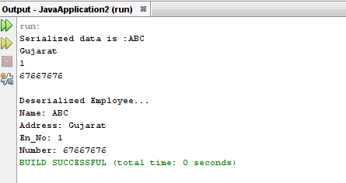
Output

Slide 35
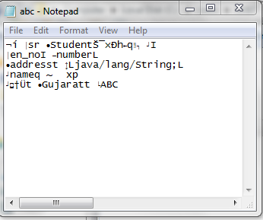
Serialized Notepad File

Slide 36
Before Internationalization
public class Demo
{
public static void main(String[] args)
{
System.out.println("Hello."); System.out.println("How are you?"); System.out.println("Goodbye.");
}
}

Slide 37
After Internationalization
import java.util.*;
public class I18NSample {
public static void main(String[] args) throws MissingResourceException {
String language;
String country;
if (args.length != 2) {
language = new String("en");
country = new String("US");
}
else {
language = new String(args[0]);
country = new String(args[1]);
}
Locale currentLocale;
ResourceBundle messages;
currentLocale = new Locale(language, country);
messages = ResourceBundle.getBundle("MessagesBundle", currentLocale);
System.out.println(messages.getString("greetings"));
System.out.println(messages.getString("inquiry"));
System.out.println(messages.getString("farewell"));
}
}

Slide 38
Running the Sample Program
MessagesBundle.properties
greetings = Hello.
farewell = Goodbye.
inquiry = How are you?
MessagesBundle_de_DE.properties
greetings = Hallo.
farewell = Tschüß.
inquiry = Wie geht's?
MessagesBundle_en_US.properties
greetings = Hello.
farewell = Goodbye.
inquiry = How are you?
MessagesBundle_fr_FR.properties
greetings = Bonjour.
farewell = Au revoir.
inquiry = Comment allez-vous?

Slide 39
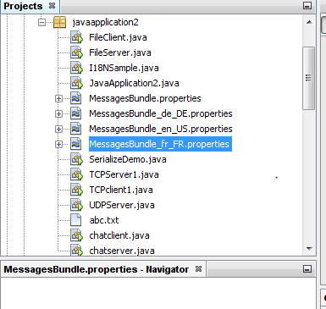
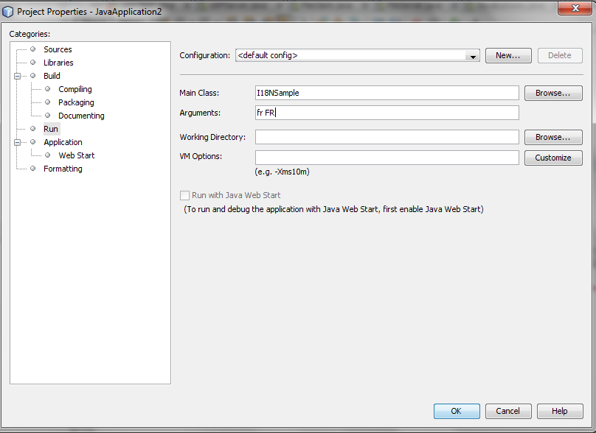

Slide 40
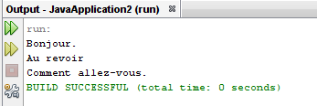
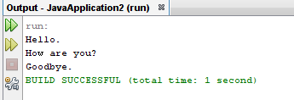
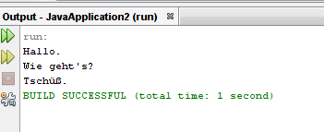
Output

